Slide 1
NFL Betting Analysis
Yusif Affara, Chase Cardon, Andrew Fish, Marcel Hujanen, Luke Ponticello

Slide 2
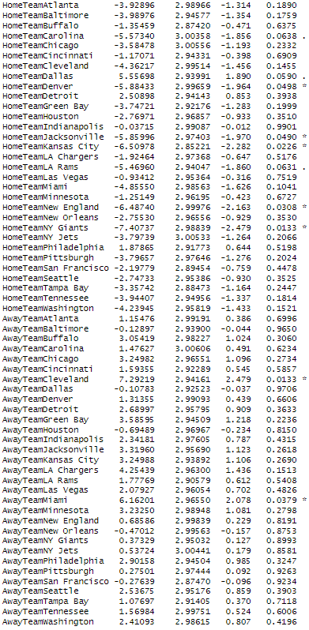
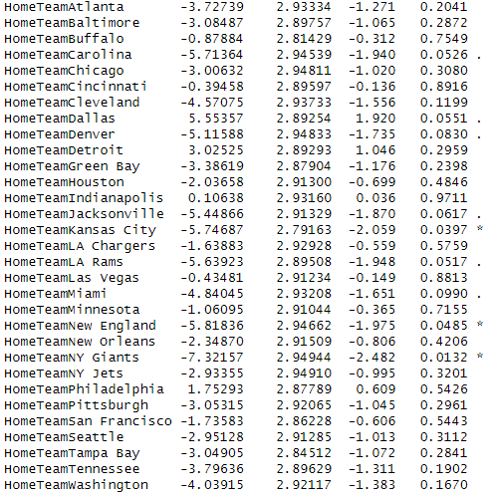
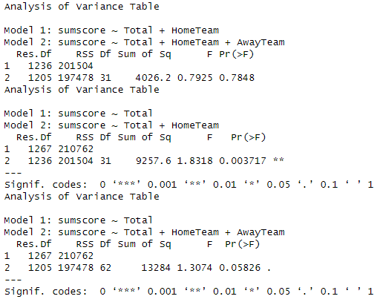
Totals
Image 2
Model | Total | HomeTeam | AwayTeam | F-Test
Model 1 | 13.389*** | NA | NA | 1.4809
Model 2 | 11.441*** | Image 1 | NA | 1.8303**
Model 3 | 10.054*** | Image 2 | Image 2 | 1.2889
Image 1
Using the Vegas Line Totals and teams to predict the actual total score 3 models were created. F-Tests and ANOVA were run and Model 2 was the best predictor of the actual total

Slide 3
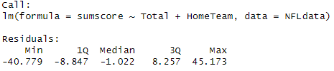

Leveraging the Total
Looking at the residuals from Model 2 we can assume that the totals are overpredicted at the higher end. We will examine both tails of the distribution but expect better results at the higher end
Examining the tails, using the quartiles, we can see that the under overall isn’t profitable as it doesn’t hit above the 52.4%. Further analysis on teams could determine that certain teams hit more than others. In the lower tail it is better to bet the over with success 52.3% which is close to profitable.
Summary of Total
Data Selection | Over | Under | Push | Percent Under
Entire | 597 | 656 | 16 | 51.7%
Lower Tail (<41) | 154 | 144 | 4 | 47.7
Upper Tail (>48) | 140 | 157 | 6 | 51.8%

Slide 4
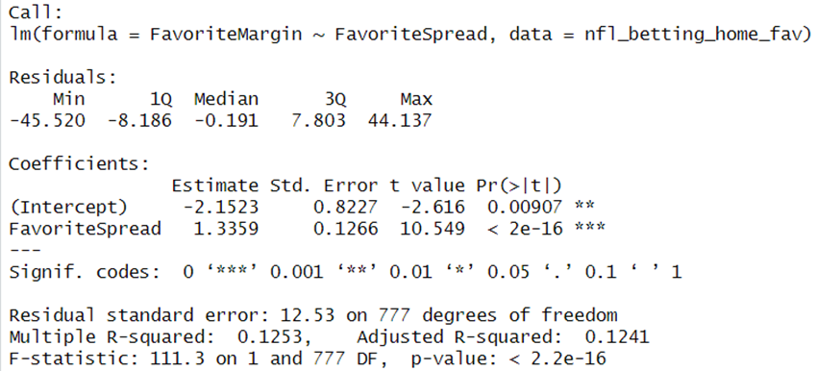
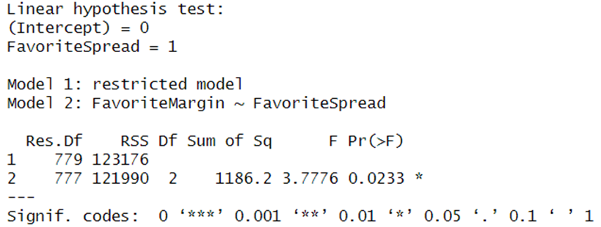
NFL Spread Efficiency for Home Favorites
The regression model shows that the Home Favorite Spread is significant
A 1-point increase in the spread is associated with a 1.34 increase in margin of victory
However, the model only explains 12.5% of the variance
The linear hypothesis test rejects null hypothesis, indicating market may be slightly inefficient

Slide 5
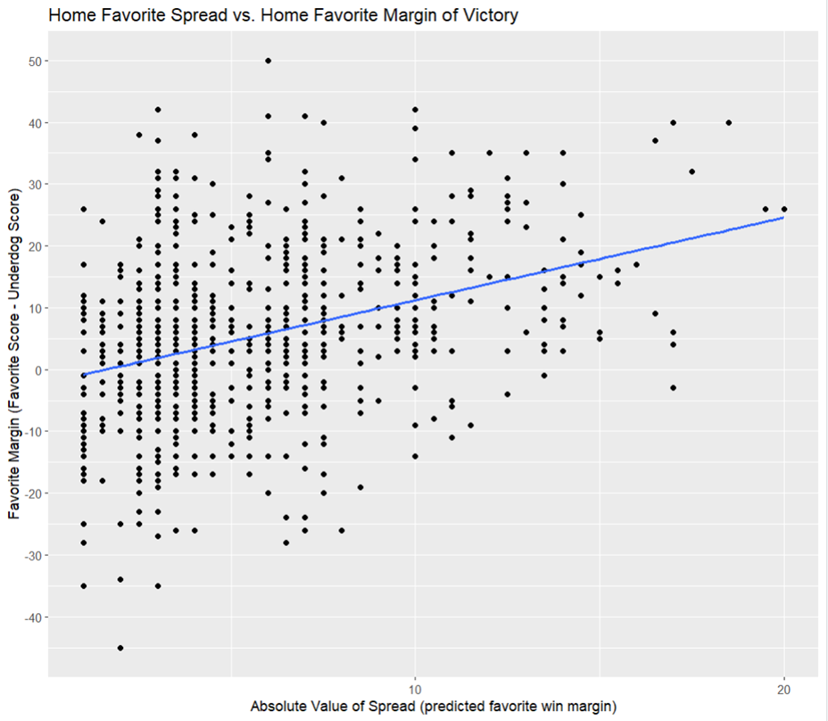
Visualizing Home Favorites Vs. Spread
Spread is a significant predictor of the outcome
Home Favorites tend to outperform spread predictions on average
The betting market slightly underestimates how much home favorites win by, particularly in games with larger predicted spreads.

Slide 6
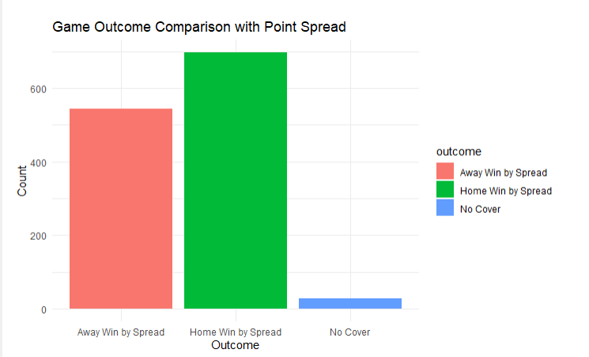

Chi-squared Test & Point Spread Visualization
A chi-squared test is a statistical technique used to evaluate whether there is a significant association between categorical variables. Given the high X-squared value and the extremely low p-value, we reject the null hypothesis, concluding there is a significant association within the contingency table's data.

Slide 7
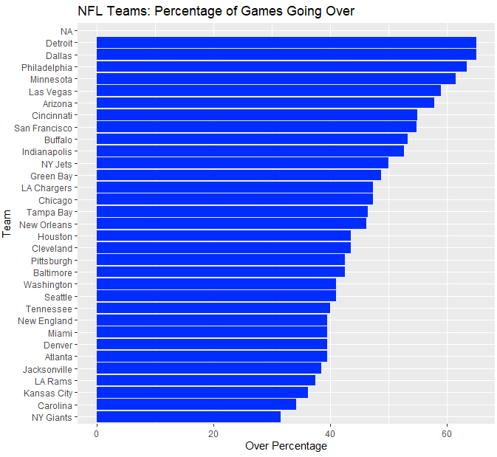
Teams vs O/U
Teams that hit the over more often typically play in high scoring games, either due to strong offenses or weaker defenses, leading to higher than expected point totals. These teams like the Lions, Dallas, and Philadelphia are more likely to have fast paced games where points accumulate quickly. As a Lions fan, I can attest to this. We see teams like the giants, panthers, and even the chiefs as teams that hit the under more often. This may have a more controlled or defensive style of play, or weaker teams often resulting in lower scoring games that stay under the total set by oddsmakers.

Slide 8
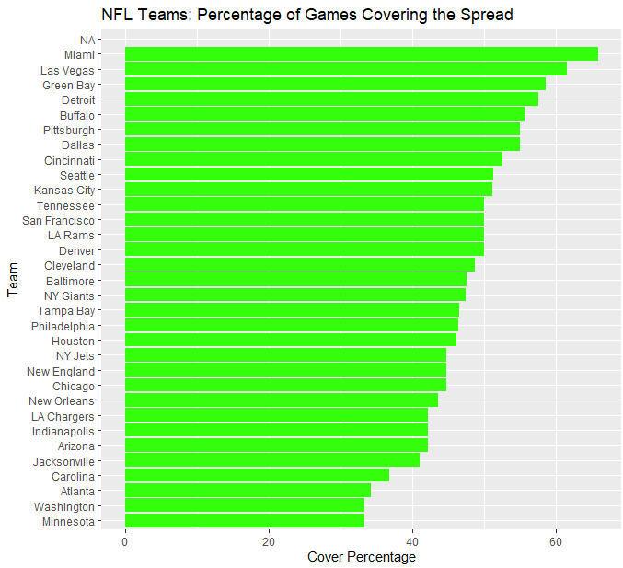
Teams vs Spread
In this visual, teams that cover the spread like Miami, Vegas, and Green Bay more often tend to outperform expectations, consistently exceeding the point spread set by oddsmakers. These teams are reliable in tight games and may be undervalued, making them strong candidates for bettors looking for consistent performance. On the other hand, teams like Minnesota, Washington, and Atlanta that cover the spread less frequently may struggle to meet expectations, indicating they might underperform or fail to live up to their odds.

Slide 9
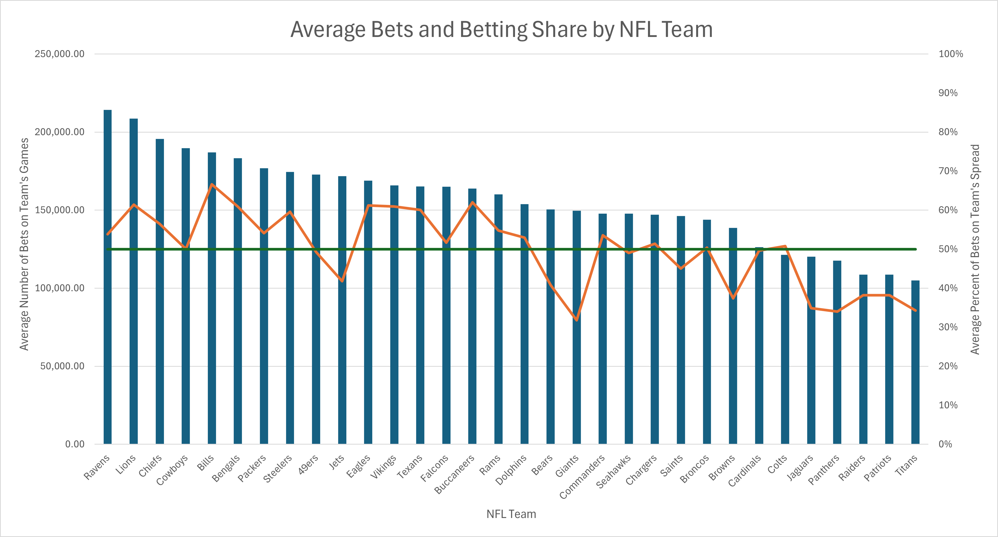
Which NFL Teams Were Bet on the Most?
This chart shows how betting behavior varies widely across NFL teams, with some teams attracting a disproportionate share of action—either in total volume of bets or in the percentage of bets placed on them to cover the spread. A few teams, like the Lions and Bills, stood out by leading in both categories, showing not only high engagement but strong bettor confidence. Interestingly, the Cowboys, often called America’s Team, didn’t dominate the chart as much as expected. Their average percentage of bets was surprisingly modest—possibly because just as many people enjoy betting against them as for them. Even the Chiefs, despite their recent success, hovered closer to 50% than anticipated. The Jets, Giants, and Browns have the opposite problem. In recent years, they have struggled really publicly and due to getting a lot of attention, possibly driving the total number of bets up, they receive a small percentage of bets on them to cover the spread.
This speaks to a broader dynamic: marquee teams naturally attract more betting interest, which sportsbooks anticipate. As a result, lines and spreads may shift in favor of the house, creating potential value in betting the other side—especially when public sentiment heavily skews toward a flashy favorite or a fun team to watch fail.

